Slide 1









My Number
Interactive Notebook
$$×$$
$$\frac{1}{2}$$
$$÷$$
$$+$$
$$−$$
$$\frac{3}{5}$$
$$7$$
Name
Class
Teacher
Term 1 Semester 1
$$5^{2}$$
$$\sqrt{9}$$
1

Slide 2
Contents
Glossary or Formula Page
Page
Date
Description
2
3

Slide 3
Tasks
24
7
30
Essential Question
Questions
Notes
Summary
8
9

Slide 4
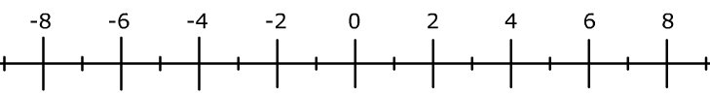
24
7
30
Date
Directed Numbers
EQ – How do I solve problems where you add and subtract directed
numbers?
What are directed numbers?
Positive or negative numbers
11

Slide 5

24
7
30
Date
Directed Numbers
EQ – How do I solve problems where you add and subtract directed
numbers?
What are directed numbers?
Positive or negative numbers
+5
How do you add two numbers?
Start here
End here
$−2+5=3$
11

Slide 6

24
7
30
Date
Directed Numbers
EQ – How do I solve problems where you add and subtract directed
numbers?
What are directed numbers?
Positive or negative numbers
+5
How do you add two numbers?
Start here
End here
$−2+5=3$
-7
How do you subtract two numbers?
End here
Start here
$−1−7=−8$
11

Slide 7

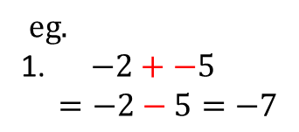
24
7
30
Date
Directed Numbers
EQ – How do I solve problems where you add and subtract directed
numbers?
How do you add a negative number?
$eg.$
1. $−2+−5$
$$=−2−5=−7$$
Ignore the + if next to $−$
11

Slide 8

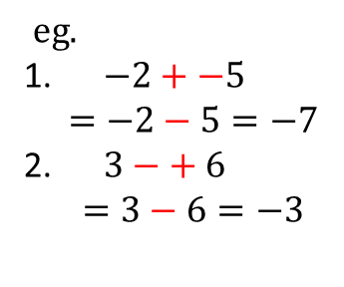
24
7
30
Date
Directed Numbers
EQ – How do I solve problems where you add and subtract directed
numbers?
How do you add a negative number?
$eg.$
1. $−2+−5$
$$=−2−5=−7$$
2. $3−+ 6$
$$=3−6=−3$$
Ignore the + if next to $−$
11

Slide 9

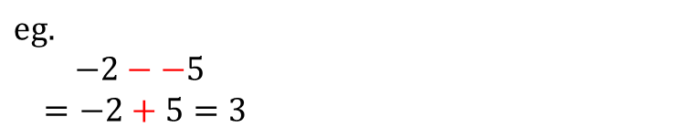
24
7
30
Date
Directed Numbers
EQ – How do I solve problems where you add and subtract directed
numbers?
How do you add a negative number?
$eg.$
1. $−2+−5$
$$=−2−5=−7$$
2. $3−+ 6$
$$=3−6=−3$$
Ignore the + if next to $−$
How do you subtract a negative number?
$$eg.$$
$−2−−5$
$$=−2+5=3$$
Replace two adjacent $−−$ with +
11

Slide 10
Notes Review
24, 7 ,30
Date
Title
Essential question
Notes complete
Notes complete with colour and diagrams
Questions completed
Contents page filed in
Formula page filled in

Slide 11
Homework
Review your notes and write a summary answering the essential question.

